Slide 1
Project C.A.S.P.
Week 12, 4/24/17
Ryan Tedeschi
Dylan Carson

Slide 2
Weekly Progress
Analyze Module almost completed
Logic for declarations/assignments working
Implemented Syntax Action Routines to accomplish this logic
All that’s left is reading the data in the module and formatting the information
Error handling
Additions to the Context Free Grammars for both C++ and JavaScript
Final Presentation
User Manual

Slide 3
Declaration & Assignment Logic
Expression resolution algorithm used to minimize expressions
This only works for simple algebraic equations, literals, and identifiers for now, and only performs actual operations on integral values (not floating point, string, etc.) – the logic is very complex
In cases where expressions cannot be resolved, the complex assignment value is stored, just not resolved
If variable “var1” is assigned a value “4” and “var2” is assigned a value “4 * var1”, “var2” will resolve to a value of 16
However, if “var1” is assigned a value “some_func() + 8”, the value will be stored as-is and will be considered variable, even if some_func() always results in the same value

Slide 4

Syntax Action Routines
AssignVar action routine
Param 1: Variable ID
Param 2: Value
ResolveExpr action routine
Param 1: Expression
Return: Resolved Value
Value of Param 1
[1]
Traverse to first child
Value of Param 1
^
Traverse to parent
[@-1]
Traverse to child one to the left of the last navigated node
Value of Param 2
ResolveExpr([1])
Invoke the ResolveExpr action routine

Slide 5

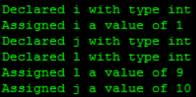
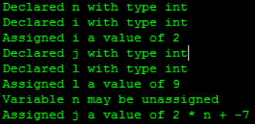

Declaration & Assignment Example

Slide 6
Weekly Tasks
Collective Tasks
Complete Analyze Module
Documentation
User Manual
Final Presentation

